Slide 1



MAKE YOUR HOME-
An AI Based Home Building Solution
Submitted By -
Aditya Pratap Singh, Devansh Pandey, Amit Gupta
Guided By-
Dr. Dilkeshwar Pandey, Professor
DEPARTMENT OF COMPUTER SCIENCE AND ENGINEERING, KIET GROUP OF INSTITUTIONS, GHAZIABAD, UTTAR PRADESH
(AFFILIATED TO DR. A.P.J. ABDUL KALAM TECHNICAL UNIVERSITY, LUCKNOW, UTTAR PRADESH, INDIA)

Slide 2

CONTENT
01
ABSTRACT
02
INTRODUCTION
03
MOTIVATION
04
IMPLEMENTATION
05
RESULT AND DISCUSSION
06
CONCLUSION
07
FUTURE SCOPE

Slide 3




ABSTRACT
"Make Your Home" represents a revolution in the realm of home improvement, offering users unparalleled access to a wealth of real-time statistical data on product prices sourced from diverse commercial supply stores.
Our platform has been meticulously crafted to serve as a one-stop destination for individuals seeking to embark on home improvement projects with clarity and confidence.

Slide 4





INTRODUCTION
Objective n° 1
Objective n° 2
Objective n° 3
By harnessing the power of data analytics, our "Make My Home" project is poised to revolutionize the procurement process, making it easier than ever for buyers to find the perfect building materials for their construction needs.
The ultimate goal of the "Make Your Home" project is to simplify the procurement process, eliminating the frustration of navigating multiple suppliers and fluctuating prices
Whether you're in need of concrete for a skyscraper or tiles for a kitchen backsplash, "Make Your Home" will be your trusted partner every step of the way, ensuring that your construction journey is marked by efficiency, cost-effectiveness, and peace of mind.

Slide 5



MOTIVATION
Our mission is simple: to revolutionize the way you procure construction supplies, whether you're undertaking a major commercial endeavor or a modest home renovation.
Through the synergistic fusion of data analytics, machine learning algorithms, and industry expertise, we aim to develop a predictive model that anticipates shifts in materials prices with unparalleled precision.
Recognizing the pivotal role that pricing fluctuations play in shaping project budgets and timelines, we are committed to harnessing cutting-edge analytical tools and techniques to provide rational accuracy in our price estimates

Slide 6

IMPLEMENTATION
01
02
03
04
USER-INTERACTION - FLUTTER APP
DATA COLLECTION - SQL DATABASE
AI/ML MODEL EXECUTION
INTEGRATING DATA THROUGH FLASK FRAMEWORK INTO APP

Slide 7
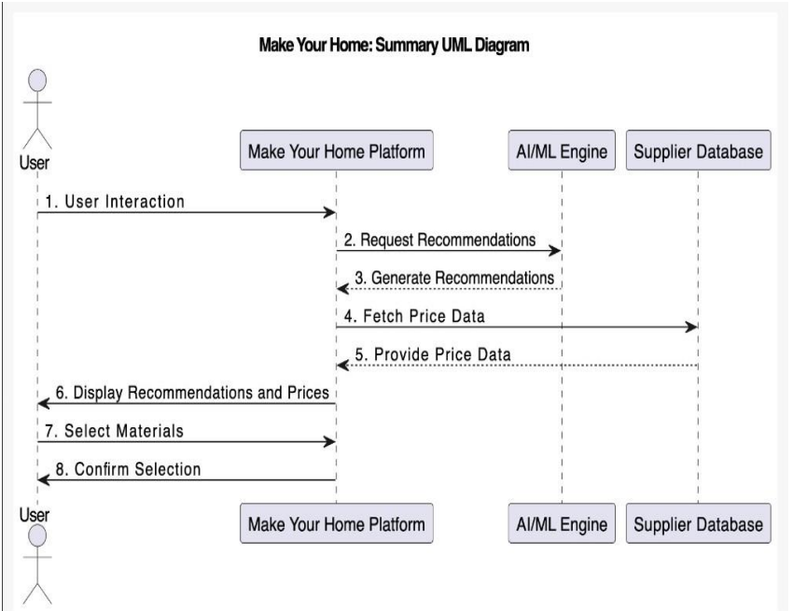
Workflow Diagram

Slide 8
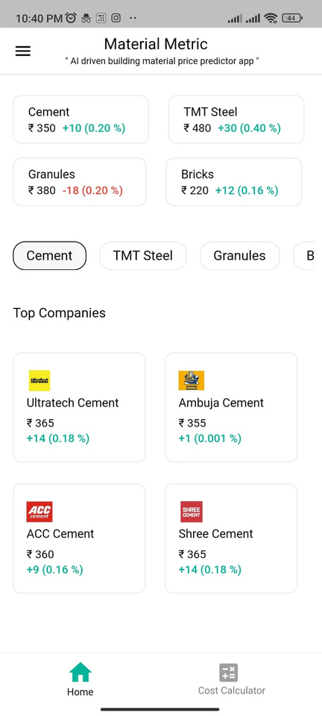
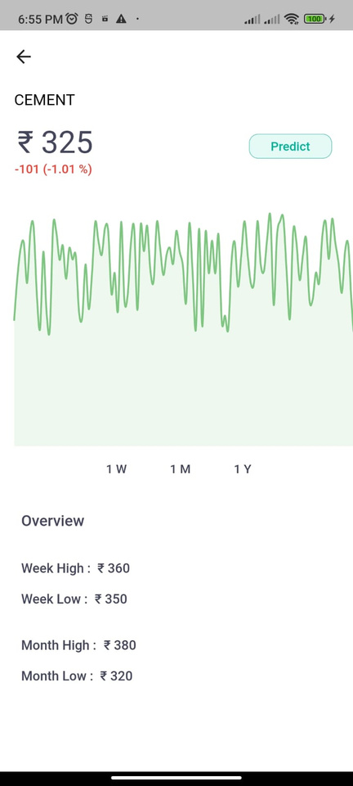
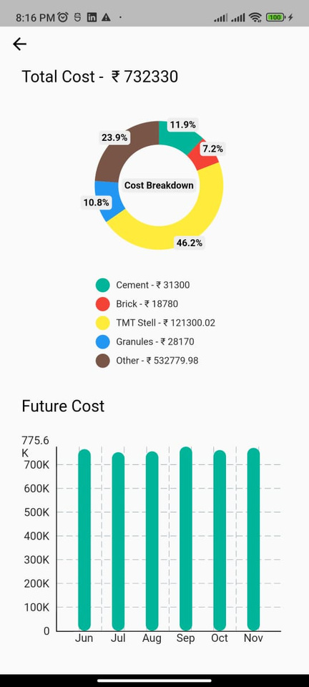
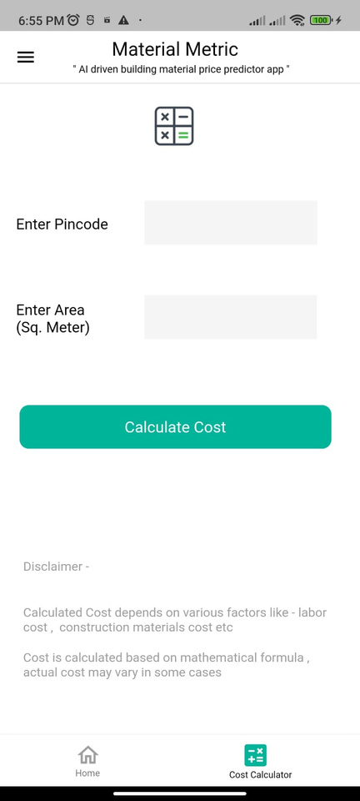
Frontend

Slide 9
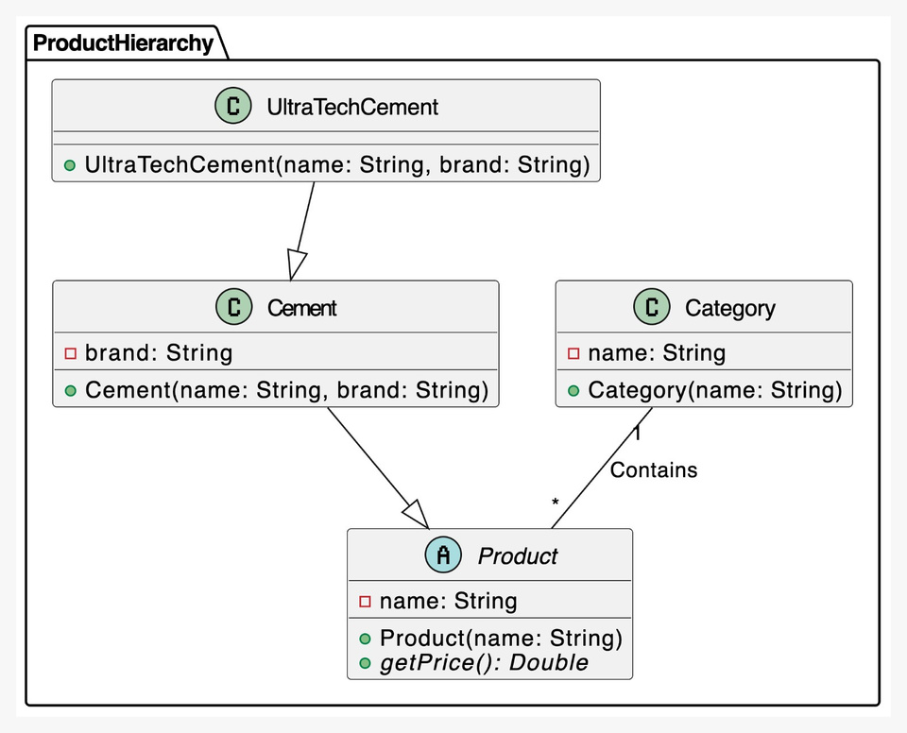
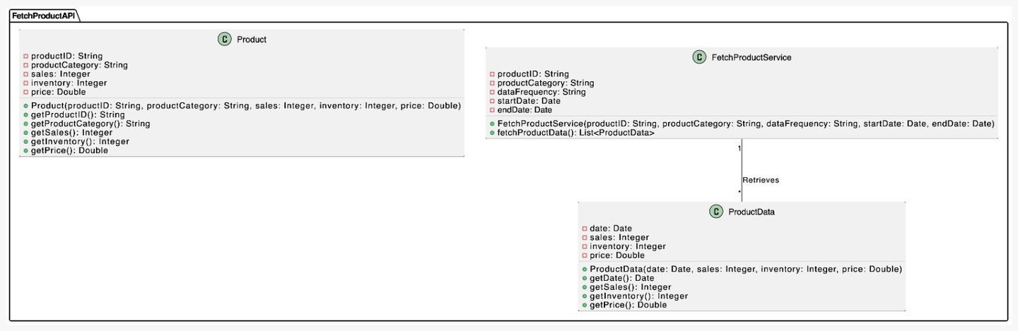
Backend

Slide 10




RESULT AND DISCUSSION
For the majority of the possible networks in the program, a test procedure was used as an initial step to filter the preferred neural network type.
In the context of the project, raw prices serve as the dependent variable, while various indicators affecting construction material prices are utilized as independent variables.
The prices fluctuate due to various factors such as supply and demand dynamics, market trends, economic conditions, and geopolitical factors.

Slide 11

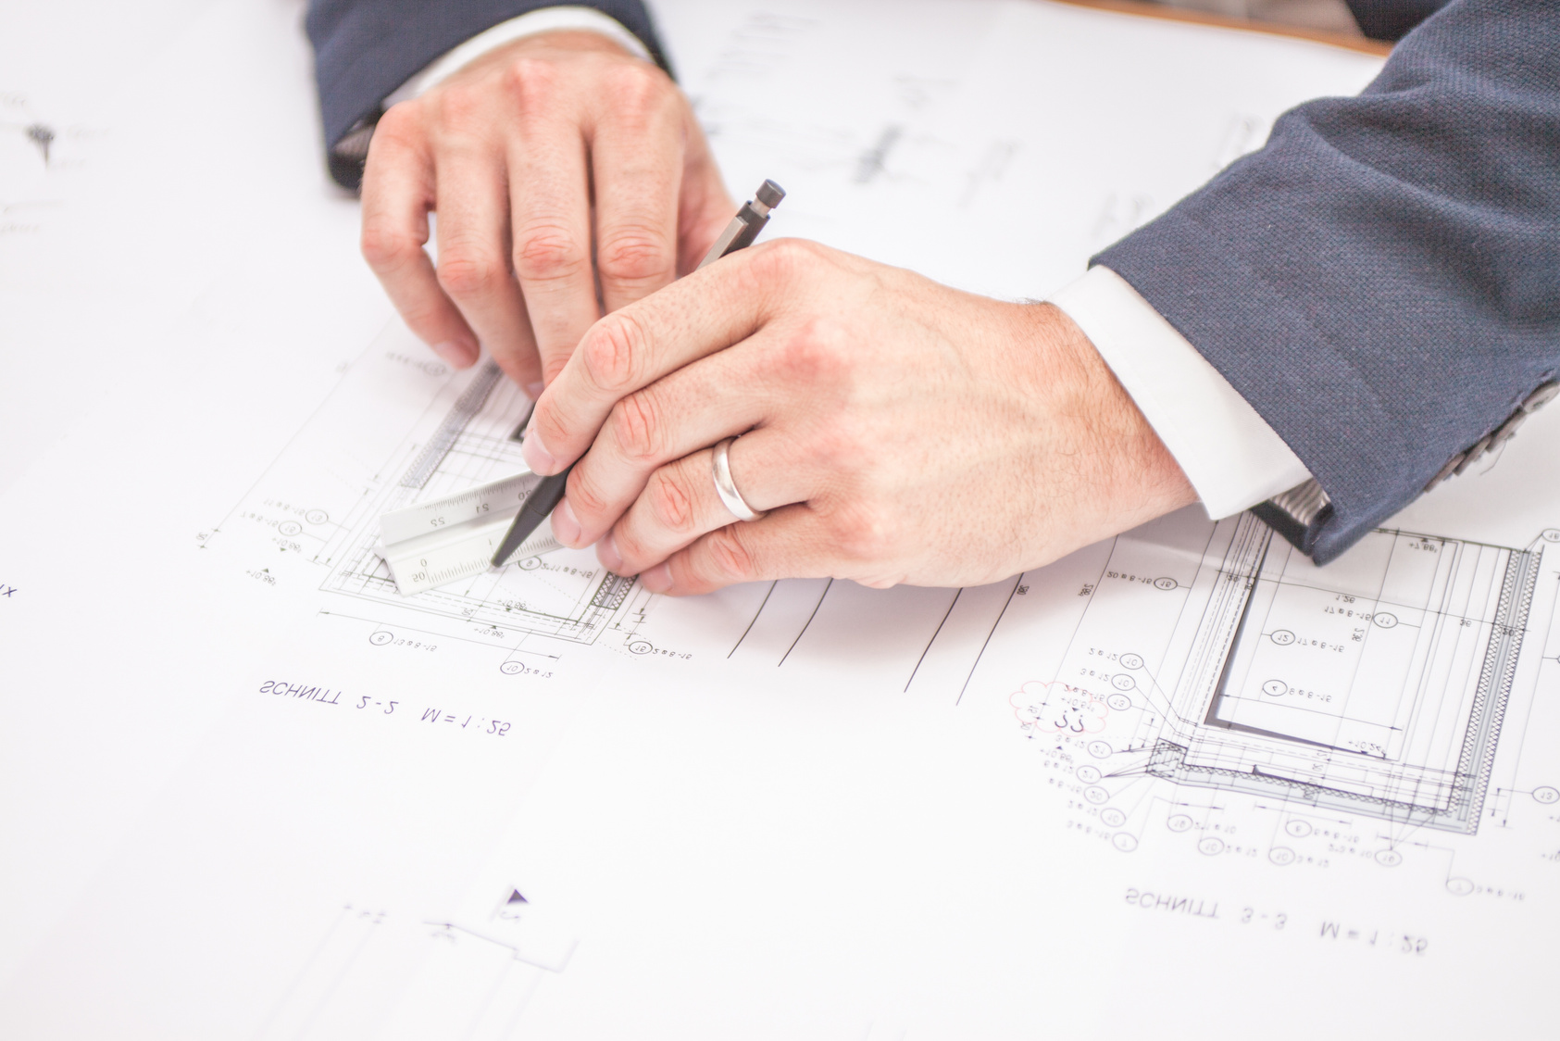
CONCLUSION
Through the amalgamation of historical pricing data, predictive models, and sophisticated algorithms, this project has demonstrated the viability and accuracy of machine learning in foreseeing fluctuations in material costs. The ability to anticipate these changes empowers stakeholders to make proactive decisions, optimize budgeting strategies, and streamline resource allocation, thereby mitigating risks and enhancing overall project efficiency. Improved profit and general expense estimation by process-level definition in accordance with process risk.

Slide 12


FUTURE SCOPE
One single platform for construction cost materials for smooth connectivity .
Customers can rate and give feedback to suppliers based on their experience.
Efficeincy of the model will be worked upon to provide better insights to customers.
CONNECTING SUPPLIERS AND BUYERS
FEEDBACK AND RATING
INCREASING EFFICIENCY

